Slide 1
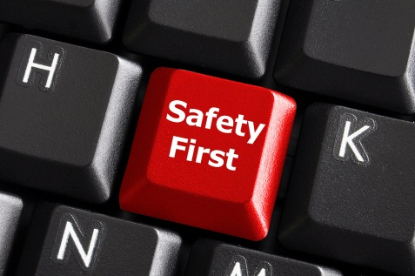
2.4 Cyber-Safety

Slide 2
Protect Your Computer
The Internet is a global network of networks with billions of connected computers.

Slide 3
Protect Your Computer
Unfortunately, not all of those computers are used by honest, law-abiding citizens.

Slide 4
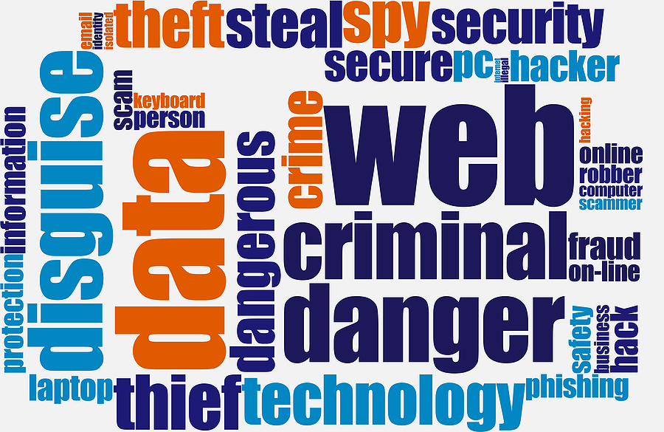
Internet Word Cloud

Slide 5
Protect Your Computer
Protect your PC from external threats by installing antivirus software and updating and running it on a regular basis.

Slide 6
Protect Your Computer
There are many vendors who produce antivirus software, and deciding which one to choose can be confusing.

Slide 7
Protect Your Computer
All antivirus software performs the same function, so your decision may be driven by recommendations, particular features, availability, or price.

Slide 8
Protect Your Computer
Installing any antivirus software, regardless of which package you choose, increases your level of protection.

Slide 9
Protect Your Computer
Antivirus software scans files or your computer's memory for certain patterns that may indicate an infection.

Slide 10
Protect Your Computer
The patterns it looks for are based on the signatures, or definitions, of known viruses.

Slide 11
Protect Your Computer
Virus authors are continually releasing new and updated viruses, so it is important that you have the latest definitions installed on your computer.

Slide 12
Protect Your Computer
Automatic Scans - Depending what software you choose, you may be able to configure it to automatically scan specific files or directories and prompt you at set intervals to perform complete scans.

Slide 13
Protect Your Computer
Manual Scans - It is also a good idea to manually scan files you receive from an outside source before opening them. This would involve saving and scanning email attachments or web downloads rather than selecting the option to open them
directly from the source.

Slide 14
Protect Your Computer
Downloading- Only download from TRUSTED sites. Use the criteria we used to evaluate web sites in the information literacy section of this training session to help you determine whether or not you can TRUST a particular website.

Slide 15
Protect Your Computer
Downloading- Never open a file directly from its source. Save the file to your computer. Right mouse click on the file and choose to SCAN the file for viruses before opening it.

Slide 16
Pause to
Search for ourselves.

Slide 17
Protect Yourself
How many of you are comfortable with the results of the search you did on yourselves?

Slide 18
Protect Yourself
How many of you are comfortable with the results of the search you did on the famous person?

Slide 19

Why Worry?
Your digital footprint can tell much more about you than you were able to find using a search engine.

Slide 20
Tips to Protect Yourself
Do not share anything online that you would not want:
your mother / grandmother
your pastor
your children or
grandchildren to see!

Slide 21
Tips to Protect Yourself
Use STRONG passwords:
You need to be able to remember your password.
Others, even those close to you, should not be able to guess your password.

Slide 22
Tips to Protect Yourself
Avoid words which can be found in a dictionary.
Avoid names and birthdays of loved ones or other easy to guess personal information.

Slide 23
Tips to Protect Yourself
8 or more characters
Use a combination of:
Letters (abc)
Numbers (123)
Special Characters (#$%_)

Slide 24
Tips to Protect Yourself
Create a phrase and use parts of it along with numbers and/or special characters.
Passwords Are Hard For Me To Remember 78 could be pahfmtr78
Once Upon A Time could be ouat_5356

Slide 25
Tips to Protect Yourself
NEVER tell anyone your password.
Do not write it down.
If you must write it down, keep it in a secure place.

Slide 26
Tips to Protect Yourself
Use Multiple passwords.
Use one password for social media sites and email.
Use another for online shopping sites.
Use another for online banking.

Slide 27
Tips to Protect Yourself
Change your passwords once in a while.
Most of the recommendations on the internet say to change your password every three months.

Slide 28
Common Sense
And Finally, a little bit of
COMMON SENSE
will go a long way toward protecting you while you
surf the World Wide Web!
COMMON SENSE
COMMON SENSE
COMMON SENSE
COMMON SENSE
COMMON SENSE

